Slide 1
BELO1010: business ethics & values
BBA: II SEMESTER
UNIT-I

Slide 2

WHAT IS ETHICS?

Slide 3
ETHICS

Slide 4
Ethical decision making

Slide 5
MEANING AND ORIGIN OF WORD ETHICS
At its simplest, ethics is a system of moral principles. They affect how people make decisions and lead their lives.
Ethics is concerned with what is good for individuals and society and is also described as moral philosophy.
The term is derived from the Greek word ethos which can mean custom, habit, character or disposition.

Slide 6
Ethics covers the following dilemmas:
how to live a good life?
our rights and responsibilities
the language of right and wrong
moral decisions - what is good and bad?
Our concepts of ethics have been derived from religions, philosophies and cultures. They infuse debates on topics like abortion, human rights and professional conduct etc.

Slide 7
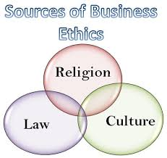
Sources of ethics

Slide 8
What are Business Ethics?
Meaning
Ethics is a branch of social science. It deals with moral principles and social values. It helps us to classify, what is good and what is bad? It tells us to do good things and avoid doing bad things.
Business ethics are the guiding principles of business function. It is the knowledge through which human behaviour is learnt in a business situation.
These are rules that business must accept and follow in its day to day operations for the welfare of society and all its stakeholders.

Slide 9
Definitions
“Business Ethics is generally coming to know what is right or wrong in the work place and doing what is right. This is in regard to effects of products/services and in relationship with the stake holders.”
—Cater Mcnamara
“Business ethics in short can be defined as the systematic study of ethical matters pertaining to the business, industry or related activities, institutions and beliefs. Business ethics is the systematic handling of values in business and industry.”
—John Donaldson

Slide 10
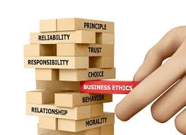
BUSINESS ETHICS

Slide 11
Relevance of Business Ethics
Credibility in the Public:
Ethical values of an organisation create credibility in the public eye. People will like to buy the product of a company if they believe that the company is honest and is offering value for money. The public issues of such companies are bound to be a success.
Credibility with the Employees:
When employees are convinced of the ethical values of the organisation they are working for, they hold the organisation in high esteem. It creates common goals, values and language. Perceived social uprightness and moral values can win the employees more than any other incentive plans.

Slide 12
Better Decision Making:
Respect for ethics will force a management to take various economic, social and ethical aspects into consideration while taking the decisions. Decision making will be better if the decisions are in the interest of the public, employees and company’s own long term good.
Profitability:
Being ethical does not mean not making any profits. Every organisation has a responsibility towards itself also i.e., to earn profits. Ethical companies are bound to be successful and more profitable in the long run though in the short run they can lose money.
Protection of Society:
Ethics can protect the society in a better way than even the legal system of the country. Where law fails, ethics always succeed. The government cannot regulate all the activities that are harmful to the society.

Slide 13
THE ETHICAL DILEMMA IN BUSINESS
THE Ethical dilemma

Slide 14
Ethical & Unethical Behavior in Management
Meaning of workplace ethics
Workplace ethics are the set of values, moral principles, and standards that need to be followed by both employers and employees in the workplace. It is the set of rules and regulations that need to be followed by all staff of the workplace.
These ethics are implemented by employers to foster both employee-employee relationship and employee-customer relationships. An organization may decide to put these ethics into writing or not—they are however meant to be followed.

Slide 15

There exist some general workplace ethics that do not need to be defined by the employer, but are common ethical behaviors employees need to exhibit.
Some common ethical behaviour in workplace are given in next slide

Slide 16
Obey The Company’s Rules & Regulation
Communicate Effectively
Develop Professional Relationships
Take Responsibility
Professionalism/Standards
Be Accountable
Uphold Trust
Show Initiative without being told
Respect Your Colleagues

Slide 17
Unethical Workplace Behaviors
Lies
Taking Credit for Others Hard Work
Verbal Harassment/Abuse
Violence
Non-Office Related Work
Extended Breaks
Theft/Embezzlement
Corrupt Practices

Slide 18
Factors influencing Business Ethics
Personal Code of Ethics
A man’s personal code of ethics that is what one considers moral is the foremost responsible factor influencing his behavior.
Legislation
It is already stated that the Government will intervene and enact laws only when the businessmen become too unethical and selfish and totally ignore their responsibility to the society. No society can tolerate such misbehavior continuously.

Slide 19
Ethical Code of the Company
When a company grows larger, its standard of ethical conduct tends to rise. Any unethical behavior or conduct on the part of the company shall endanger its established reputation, public image and goodwill. Hence, most companies are very cautious in this respect. They issue specific guidelines to their subordinates regarding the dealings of the company.

Slide 20
Social Pressures
Social forces and pressures have considerable influence on ethics in business. If a company supplies sub-standard products and get involved in unethical conducts, the consumers will become indifferent towards the company. Such refusals shall exert a pressure on the company to act honestly and adhere strictly to the business ethics. Sometimes, the society itself may turn against a company.

Slide 21
Ethical Climate of the Industry
Modern industry today is working in a more and more competitive atmosphere. Hence only those firms, which strictly adhere to the ethical code, can retain its position unaffected in its line of business. When other firms, in the same industry are strictly adhering to the ethical standards, the firm in question should also perform up to the level of others. If the company’s performance is below than other companies, in the same industry, it cannot survive in the field in the long run.

Slide 22
Values !

Slide 23
Values: Definition
According to I. J. Lehner and N.J. Kube, “Values are an integral part of the personal philosophy of life by which we generally mean the system of values by which we live. The philosophy of life includes our aims, ideals, and manner of thinking and the principles by which we guide our behavior
According to T. W. Hippie, “Values are conscious or unconscious motivators and justifiers of the actions and judgment”

Slide 24
A value is a shared idea about how something is ranked in terms of desirability, worth or goodness. Sometimes, it has been interpreted to mean “such standards by means of which the ends of action are selected”.
Values

Slide 25
Characteristics of Value
Values are different for each person.
These can be defined as ideas or beliefs that a person holds desirable or undesirable.
The variability in that statement is, first, what a person could value, and second, the degree to which they value it.
Following are the main characteristics of values:

Slide 26
Characteristics of values: Conti.
Personal values can be influenced by culture, tradition, and a combination of internal and external factors.
These are relatively permanent.
These are more central to the core of a person.
Most of our core values are learned early in life from family, friends, neighborhood school, the mass print, visual media and other sources within the society.
Values are loaded with effective thoughts about ideas, objects, behavior, etc.

Slide 27
Characteristics of values: Conti.
Values can differ from culture to culture and even person to person.
Values play a significant role in the integration and fulfillment of man’s basic impulses and desire stably and consistently appropriate for his living.
They are generic experiences in social action made up of both individual and social responses and attitudes.
They contain a judgmental element in that they carry an individual’s ideas as to what is right, good, or desirable.

Slide 28
values

Slide 29
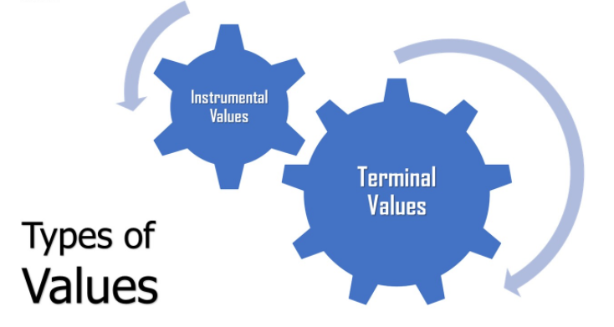
Types/classification of Values

Slide 30
Terminal Values
These are values that we think are most important or most desirable.
These refer to desirable end-states of existence, the goals a person would like to achieve during his or her lifetime.
They include happiness, self-respect, recognition, inner harmony, leading a prosperous life, and professional excellence.

Slide 31
Instrumental Values
Instrumental values deal with views on acceptable modes of conductor means of achieving the terminal values.
These include being honest, sincere, ethical, and being ambitious. These values are more focused on personality traits and character.
There are many typologies of values. One of the most established surveys to assess individual values is the Rokeach Value Survey.
This survey lists 18 terminal and 18 instrumental values in alphabetical order.

Slide 32
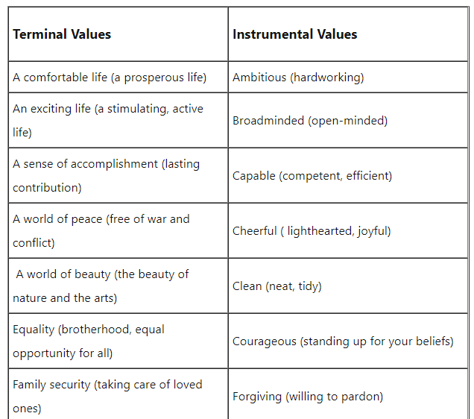

Slide 33
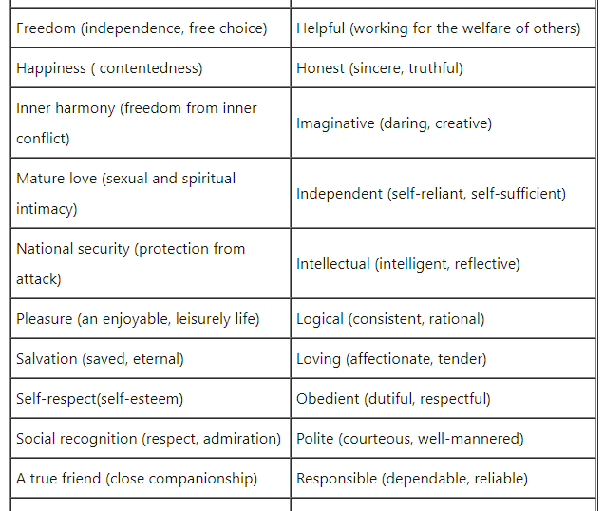

Slide 34
Other types of values include:
1. Personal Value — The principles and ideologies that a person follows in personal life. Cleanliness, consistency, punctuality, search of knowledge and simple life etc. are of this category.
2. Moral values -Moral values are relative values that protect life and are respectful of the dual life value of self and others. The great moral values, such as truth, freedom, charity, etc., have one thing in common. When they are functioning correctly, they are life protecting or life enhancing for all.
3.National Value/ political value — Principle, which encourage a person to imbibe the feelings of patriotism and natural integration. Patriotism, national unity, national awaking etc. are the values categorized in political values. Their aim is to make the person an able citizen, so that they can be aware of their rights and duties.

Slide 35
4. Religious Value — Persons believe in a particular thought which is a guide for reasoning between good and happy.
5. Civic Value — Principles, which guide in the dos and dont’s of the citizens.

Slide 36
your identity and values

Slide 37
Difference between ethics and values

Slide 38
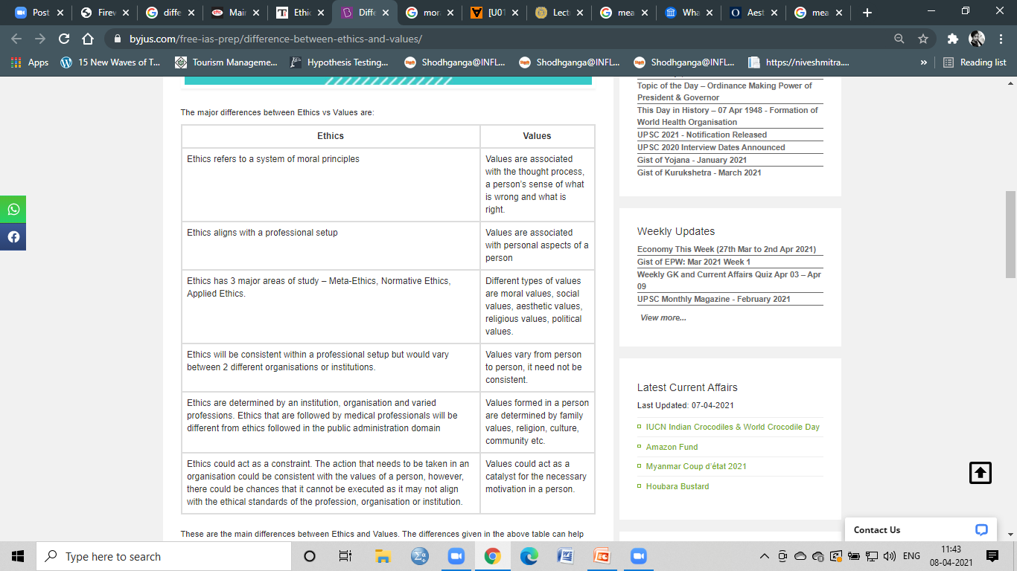

Slide 39
Factor affecting values
VALUES
Community or society
Media
Relatives
Family
Religion
Friends & peers

Slide 40
Value System in an Organization
Organisational values describe the core ethics or principles which the company will abide by, no matter what.
They inspire employees’ best efforts and also constrain their actions. Strong, clearly-articulated values should be a true reflection of your organisation’s aspirations for appropriate workplace behaviour, and play an important role in building a positive culture at your organisation.
ROLE OF VALUES IN ORGANISATION

Slide 41
Importance of Well-drafted organisational values:
Guide staff behaviour, as well as strategic and operational decisions
Provide a solid foundation for your employment policies, and “fill the gaps” where policies are silent
Over time, improve the organisation’s ethical character as expressed in its operations and culture
Demonstrate integrity and accountability to external stakeholders
Set the organisation apart from its competitors
Reduce risk of inappropriate behaviour
Strengthen the employment value proposition

Slide 42
Developing values system in your organisation
The process usually involves:
in-depth discussions with leaders, managers and sometimes other stakeholders that you select (such as union representatives or customers)
focus groups with employees
listening to all their views about what your organisation stands for now, and (if anything) what ethical shifts the organisation wants to make in future
understanding how the company plans to ensure that its culture, performance and employee experience continue to improve
preparing draft values, based on what your employees and stakeholders tell us
working collaboratively with senior leaders to refine and finalise the values, and develop an implementation strategy.

Slide 43
Examples of Some Organizational Value Systems:
To inculcate the value systems, organizations may document their value statements to provide a sense of direction to their employees. All employees shape their pattern of behaviour based on such espoused value statements of the organization. Here we are illustrating some of the model value systems of the Tata Group & Infosys,

Slide 44
Tata Group:
The Tata Group’s core value systems are improvement of quality of life of the communities. The group believes in the following five core values.
Integrity:
We must conduct our business fairly, with honesty and transparency. Everything we do must stand the test of public scrutiny.
Understanding:
We must be caring, show respect, compassion, and humanity for our colleagues and customers around the world, and always work for the benefit of the communities we serve.
Excellence:
We must constantly strive to achieve the highest possible standards in our day-to-day work and in the quality of the goods and services we provide.
Unity:
We must work cohesively with our colleagues across the group and with our customers and partners around the world, building strong relationships based on tolerance, understanding, and mutual cooperation.
Responsibility:
We must continue to be responsible and sensitive to the countries, communities, and environments in which we work, always ensuring that what comes from the people goes back to the people many times over.

Slide 45
Infosys Technologies:
Infosys Technologies’ value systems are empowered by C-Life, which is explained below:
Customer’s delight:
A commitment to surpass our customers’ expectations.
Leadership by example:
A commitment to set standards in our business and transactions and be an exemplar for the industry and our own teams.
Integrity and transparency:
A commitment to be ethical, sincere and open in our dealings.
Fairness:
A commitment to be objective and transaction oriented, thereby earning trust and respect.
Pursuit of excellence:
A commitment to strive relentlessly, to constantly improve ourselves, our teams, our services and products so as to become the best.

Slide 46
Question :
how to develop core values for your business ??

Slide 47
Benefits of having core values in management
“Values determine culture
Culture determines Behavior
Behavior determines Outcome”
- Rohan Dredge
Some of the major benefits of values in management are given as:
Business blooms
Employee Involvement
Gain Goodwill
Healthy Attrition Rate
Attract new clients/employees
Customer Delight

Slide 48
Values for Indian Managers.
Integrity
Optimism and enthusiasm
Commitment to growth
Responsibility
Willingness to take risk
Vision
Emotional intelligence
Expertise in industry

